Slide 1
Foods that Change Flavors
Taste
M Ulfers​

Slide 2

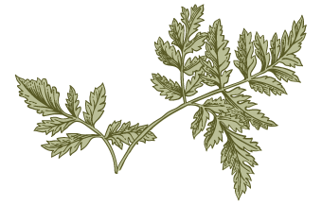
Agenda
A
Introduction
How do we taste?
What do we taste?
What interferes?
What interacts?
How can we apply this?

Slide 3
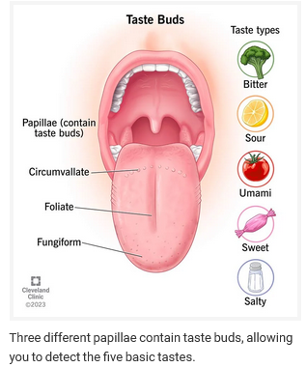
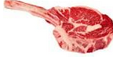
Biology of Taste
Taste is one part of “flavor”
There are 5 basic tastes (tastants)
Flavor is a combination of taste, odor, and
physical/chemical sensations
Taste buds are in the visible papillae
https://my.clevelandclinic.org/health/body/24684-taste-buds

Slide 4
Fun Facts: about your buds
https://my.clevelandclinic.org/health/body/24684-taste-buds
What do taste buds do?
When you chew food, your teeth and saliva work together to break it down. This breakdown releases chemicals from the food that flow to your taste buds. These chemical signals also travel up your nasal passages to receptors in your nose.
Other cells in your mouth and throat contain receptors that register how hot or cold a food or drink is. “Hot” includes temperature and spice. “Cold” includes temperature and certain flavor sensations, like mint or eucalyptus.
Multiple sensitive cells work together to shape your experience of eating and drinking.
Where are taste buds located?
Taste buds primarily cover your tongue. To a lesser extent, you also have taste buds on the roof of your mouth and in your throat. The taste buds on your tongue are housed inside visible bumps called papillae. There are three types of papillae that contain taste buds:
Fungiform: Located on the sides and tip of your tongue. They contain approximately 1,600 taste buds.
Circumvallate: Located on the back of your tongue. They contain approximately 250 taste buds.
Foliate: Located on the back portion of your tongue, on each side. There are about 20 of these papillae, and they contain several hundred taste buds each.
How many taste buds do humans have?
The average adult has anywhere from 2,000 to 10,000 taste buds. We lose taste buds as we age, which means that children have more taste buds than adults. Sizes and numbers of taste buds vary from person to person.
These differences mean that, although everyone detects the same five tastes, perceptions and experiences of these tastes vary.

Slide 5
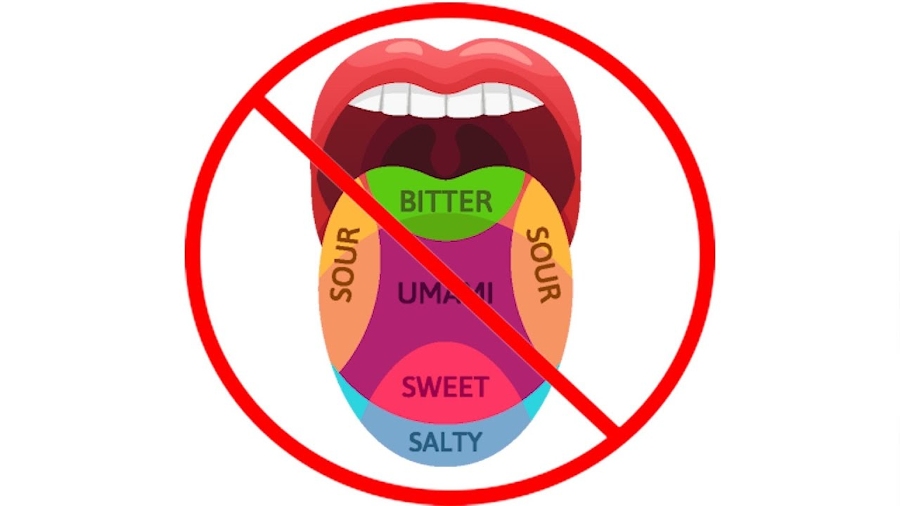
https://www.youtube.com/watch?app=desktop&v=0klEcayEJ_o

Slide 6
Variations: low, medium and super-tasters
Genetics
Variation in tongue anatomy and number of papillae
Culture (habituation)
Here’s a great article on one woman’s search to understand why she didn’t like wine and the science of taste (spoiler: it wasn’t her fault):
Who will enjoy wine the most?
https://www.newyorker.com/tech/annals-of-technology/how-science-saved-me-from-pretending-to-love-wine

Slide 7
Maturing Tastes: debatable
Child
Naïve tastes
  doesn’t detect the subtleties to appreciate wine
Very sensitive
  Wine is too sour and bitter
Adult
Refined tastes
  learned to detect nuance and appreciates it!
Less sensitive
  Doesn’t detect as much unpleasant flavor

Slide 8
About those 5 Tasants
Taste buds detect five basic tastes, including:
Sweet: Sweet foods mostly contain some form of sugar (sucrose, glucose, fructose and lactose). They include foods like honey, fruit and ice cream.
Salty: Salty foods contain table salt (sodium chloride) or mineral salts, like magnesium or potassium. Think of foods like pretzels, chips and movie theater popcorn.
Bitter: Bitter foods may contain ingredients like caffeine or compounds from plants, among others. Bitter is a complex taste regarding whether your taste buds recognize it as “good” or “bad.” For example, some people like bitter foods, like coffee and dark chocolate, while others don’t.
Sour: Sour foods, like citrus fruits and vinegar, often contain some form of acid (acetic acid, citric acid, lactic acid).
Umami: Umami is a savory, rich or meaty flavor. Many foods that your taste buds register as umami contain a substance called glutamate. Umami foods include tomatoes, asparagus, fish, mushrooms and soy.
??? There may be others.. Fats, alkaline, metallic ????
https://my.clevelandclinic.org/health/body/24684-taste-buds

Slide 9
Other parts of flavor (what we aren’t talking about)
Physical sensations: astringency, hot and cold
“spicy” (capsaicin) only register as heat –no taste
mint registers as cold
https://www.winespectator.com/articles/will-spicy-food-affect-my-sense-of-taste 47776#:~:text=Capsaicin%2C%20the%20active%20component%20of,but%20the%20receptors%20will%20regenerate
Odors: many, many different chemicals. Registered in the nasal passages. May also be genetic and/or trained differences in perception of these. Will be affected by temperature
That’s it.

Slide 10
https://www.apps.fst.vt.edu/extension/enology/extonline/foodwine.html
Acidic=sour here.
Salt enhances/magnifies perception of tannins and acidity

Slide 11
Sweet covers up sweet
General agreement that very sweet food will “drown out” the sweet in wines
(which are almost always less sweet than the food) Sweet foods before wine lower the perception of sweet components in wine
But this guy says… Foods that are sweet (from sugar, fruit or fruit juice, hoisin sauce, honey or the like) or high in umami (well-aged beef, tomatoes, meat stocks or sauces) make any wine taste stronger-by which I mean more emphatic in its basic taste (sourness, bitterness or sweetness). - Wine and Food In Balance Program https://www.epicurean.com/articles/food-and-wine-interactions.html

Slide 12
Sour covers up sour
General agreement that very sour/acidity food will “drown out” the sour/acidity in wines
Vinaigrette throws wine off-kilter Salad is difficult to pair with wine because your taste buds adapt to the sourness of vinaigrette. After eating it, you will be able to detect only sourness that’s higher in concentration than that of the dressing. Many wines depend on a delicate balance of sweet and sour, but after your taste buds adapt to vinaigrette, you will taste only a seemingly overbearing sweetness in the wine. https://www.rd.com/list/foods-affect-sense-taste/
The acid makes wines taste “flabby”
https://www.dcanterwines.com/blogs/wine-life/wine-and-salad-pairings/#:~:text=The%20acidity%20of%20the%20vinaigrette,the%20other%20flavors%20to%20shine
In contrast, sour components (vinegars, citrus, dry wine reductions) and salty components (including soy sauce, olives, olive brine) make wines taste milder-fruitier, less acidic, less bitter. … See for yourself: taste your Cabernet, then lick a wedge of lemon, and try your wine again. The wine tastes great; its fruit, acid and tannins are in balance, just as the winemaker intended them to be. Try one more experiment. Taste the Cabernet again, sprinkle a little salt on an apple slice, and try the wine again. Delicious. Unless you preferred that stronger taste resulting from the sweet apple, of course. Wine and Food In Balance Program https://www.epicurean.com/articles/food-and-wine-interactions.html

Slide 13
Bitter – very sensitive
IDK
I also avoid the foods that are known to fight with wine: asparagus, artichokes, oily fishes (no tuna fish sandwiches!), vinegar and pickled items. Some tasters avoid coffee and tea, which both also have a lot of tannins, before a tasting. Bitter and spicy foods can also sensitize taste buds, causing tannins or acidity to seem harsher.-https://www.winespectator.com/articles/which-foods-beverages-to-avoid-before-wine-tasting-57544
“Bitter foods and bitter wines do not cancel out each other” - https://www.apps.fst.vt.edu/extension/enology/extonline/foodwine.html

Slide 14
Salty
IDK
Salt can magnify the influence of tannins in red wines and acidity in white wines” https://www.apps.fst.vt.edu/extension/enology/extonline/foodwine.html
Salt blocks grapefruit’s tartness: It may sound unpalatable, but salting grapefruit sweetens it. The fruit has both bitter and sweet compounds. Salt blocks the bitter compounds, allowing sweet flavors to be more detectable- https://www.rd.com/list/foods-affect-sense-taste/
In contrast, sour components (vinegars, citrus, dry wine reductions) and salty components (including soy sauce, olives, olive brine) make wines taste milder-fruitier, less acidic, less bitter. … See for yourself: taste your Cabernet, then lick a wedge of lemon, and try your wine again. The wine tastes great; its fruit, acid and tannins are in balance, just as the winemaker intended them to be. Try one more experiment. Taste the Cabernet again, sprinkle a little salt on an apple slice, and try the wine again. Delicious. Unless you preferred that stronger taste resulting from the sweet apple, of course. Wine and Food In Balance Program https://www.epicurean.com/articles/food-and-wine-interactions.html
Maybe it matters how salty??

Slide 15
Lipids…aka fats hide tannins
Solid evidence that fats “hide” tannins
They also conducted taste tests to see if consuming oils like olive oil or grapeseed oil affected the perceived flavor of wine. Volunteers noted that consuming oil before drinking wine mellowed the astringency of the tannins and made the wines taste more fruity than bitter.
Combining their findings, researchers concluded that tannins bind to lipids, making them less available to bind to your taste buds and mellowing their flavor. If you are averse to super bitter wines, this is good news. https://www.eatingwell.com/article/7892642/weird-thing-make-wine-taste-different/
Nuclear magnetic resonance and optical and electron microscopy showed an interaction between catechin, a majority component of grape tannins, and lipid droplets from a phospholipid-stabilized oil-in-water emulsion, characterized by (a) an increase in the droplet size in the presence of catechin, (b) slowing of their size growth over time, and (c) an increase in lipid dynamics in the droplet interfacial layer. Those results were strengthened by sensory analysis, which demonstrated that dietary oils decrease the perception of astringency of grape tannin solutions. Our results highlight that dietary lipids are crucial molecular agents impacting our sensory perception during wine consumption.–from actual researcharticle

Slide 16
Asparagus is weird
It does something but why or how isn’t generally agreed on
https://marczykfinefoods.com/miscellany/2021/5/14/asparagus-and-wine-not-as-simple-as-youd-think
https://www.tastingtable.com/1279286/why-asparagus-clashes-most-wine-how-fix/#:~:text=Part%20of%20the%20reason%20is,party%20featuring%20an%20asparagus%20dish
https://www.canadianliving.com/food/entertaining/article/why-does-asparagus-ruin-the-taste-of-wine
Asparagus, Brussels sprouts, broccoli, cauliflower, cabbage, and even the beloved kale all have high levels of organosulfur compounds, AKA straight up sulfur. The same vegetables that can give you serious, uh, gas can also make wine taste awful. When the compounds come in contact with wine, it makes the wine taste overly sulfuric and flawed, like a glass of burnt rubber or rotten eggs -https://www.bonappetit.com/story/foods-that-dont-pair-with-wine
Or the pee thing
Or the bitterness

Slide 17

Artichokes and cynarine
Cynarine binds to a sugar receptor in the taste buds, when washed off by a drink there’s a burst of phantom sweetness
Whatever you drink will taste much sweeter than it is.
This can be fun
A chemical in the vegetable called cynarin latches on to sweet receptors on your tongue without activating them. If you drink water after eating artichokes, the cynarin molecules wash away from the receptors. This sudden release simulates a sensation of sweetness, though it’s only a phantom taste. - https://www.rd.com/list/foods-affect-sense-taste/

Slide 18
à chacun son goût

Slide 19
For fun
https://www.apps.fst.vt.edu/extension/enology/extonline/foodwine.html best overall source on this topic
https://www.bbc.com/future/article/20141214-how-to-hack-your-taste-buds
And what about toothpaste https://www.foodandwine.com/news/tropicana-orange-juice-toothpaste-taste#:~:text=So%20despite%20emerging%20around%20the,gross%20after%20brushing%20your%20teeth

Slide 20
Thank you
Mirjam Nilsson​
mirjam@contoso.com
www.contoso.com

